Slide 1

Project management systems (PMS)
for
Guwahati Municipal Corporation (GMC)
Offshore Office: 42, Ananda Nagar, Sixmile Guwahati-781022
Assam, India
Ph: 9854051520/22

Slide 2

project management system (PMS) features
Track Project from planning, execution to completion
Physical and Financial Progress
Geotagging integration
Project level notes maintenance
Solution for all types of projects

Slide 3
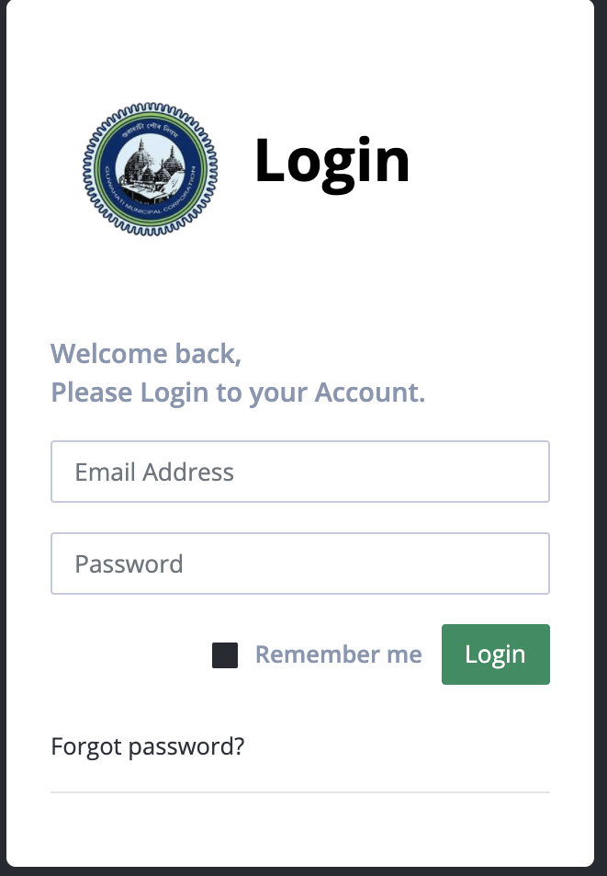
Login
Tools details -
Site
www.gmcpms.in
Login
User ID
Password
Enter
Authorization

Slide 4
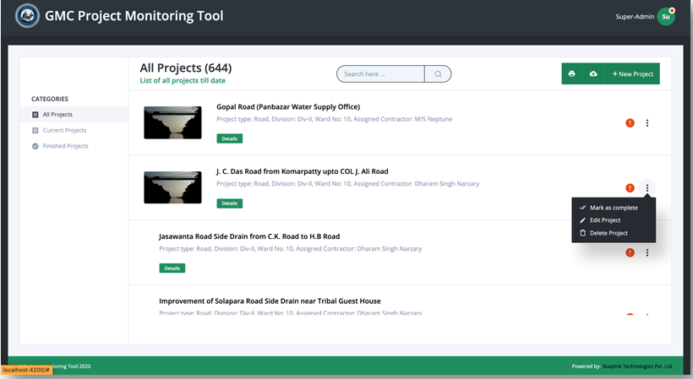
Dashboard – all projects
All Projects – active and completed will be shown
Takes to project details page on clicking

Slide 5
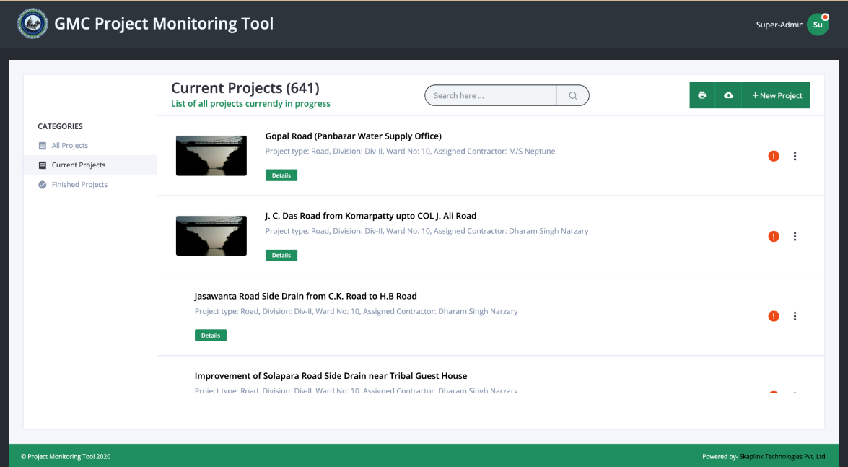
CURRENT PROJECTS
Displays the Current Projects.
Clicking on any project here, will lead to the project’s details page.

Slide 6
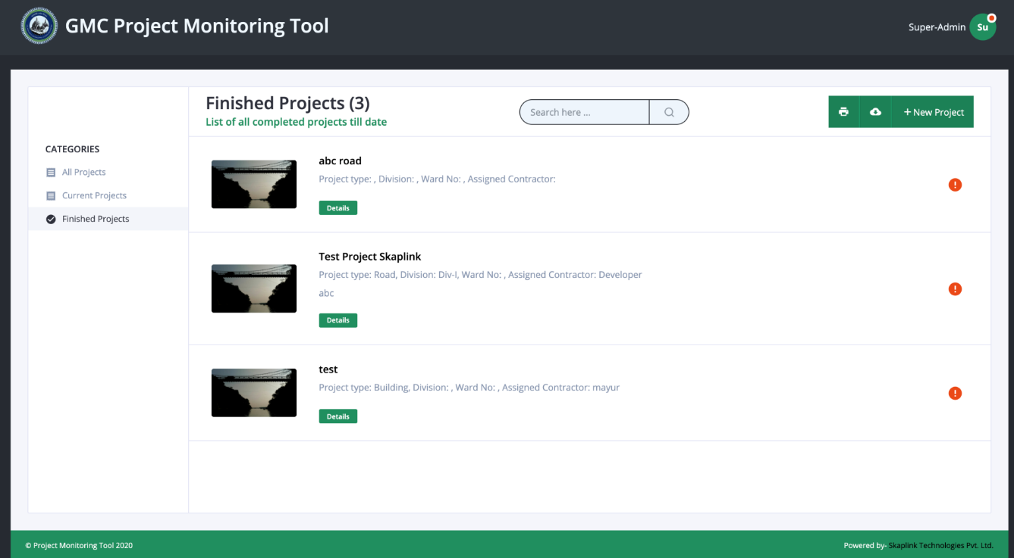
FINISHED PROJECTS
Displays the Finished Projects.
Clicking on any project, will lead to the project’s details page.

Slide 7
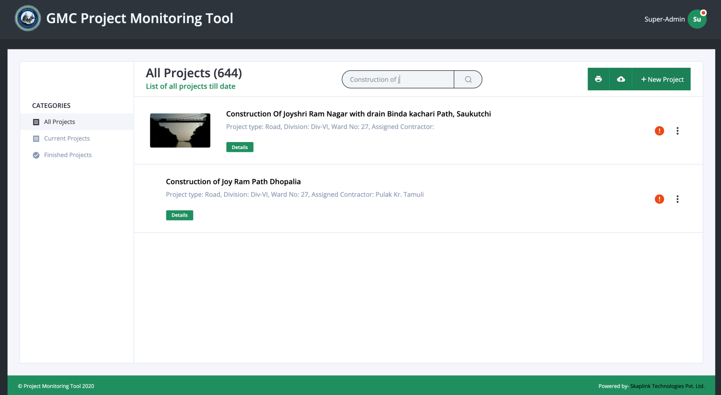
FILTER PROPERTY
This way we can filter and search a distinct project.

Slide 8
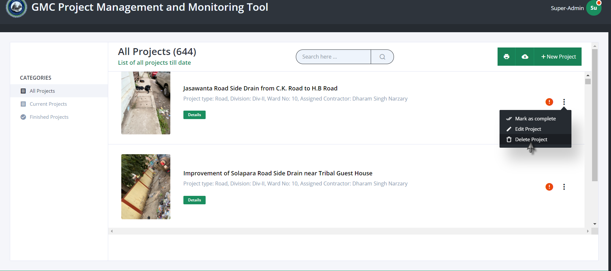
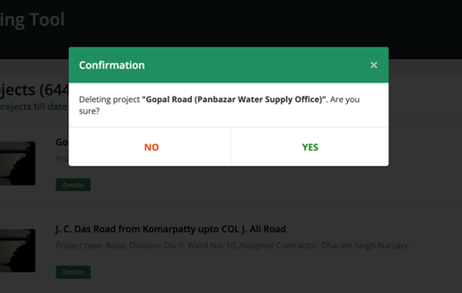
DELETE PROPERTY
We can directly click on the delete project button.
Confirmation message will pop up.

Slide 9
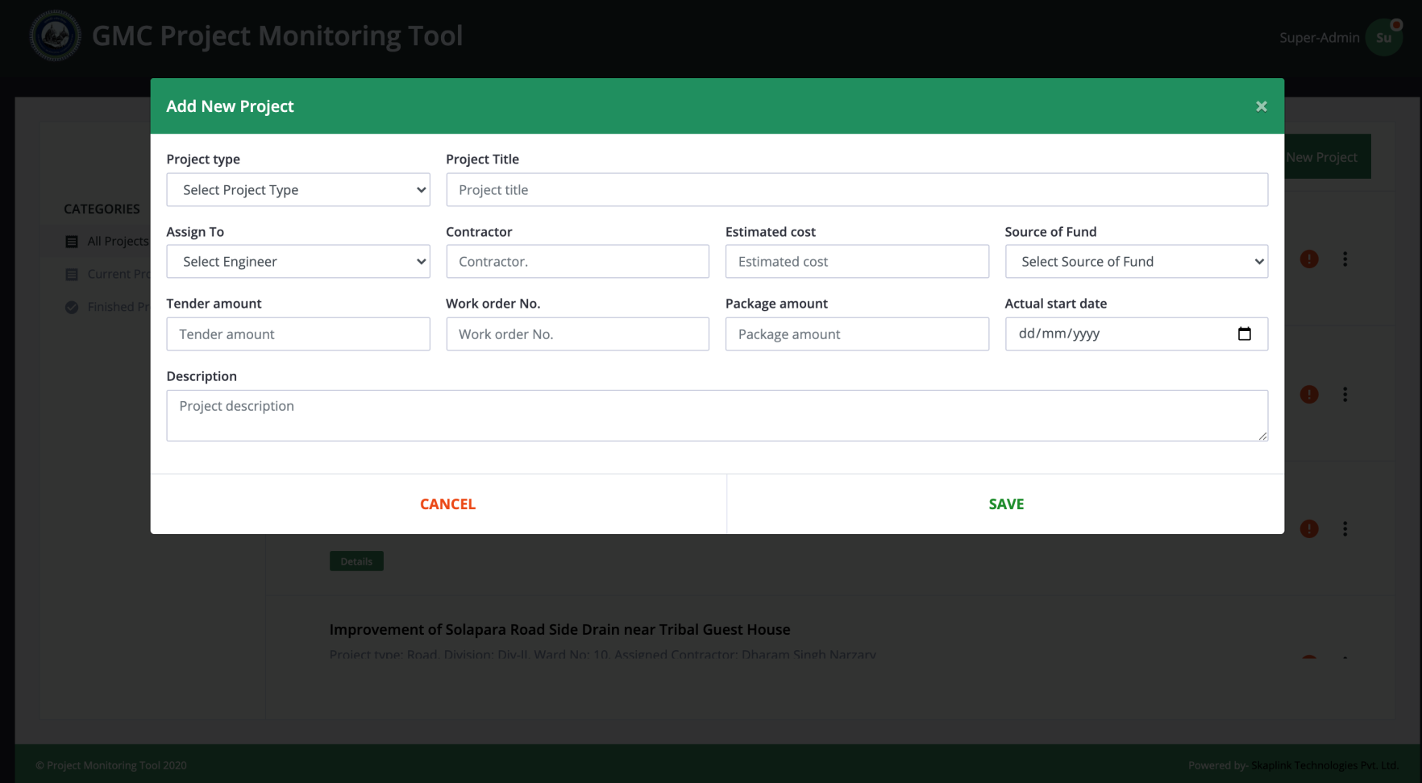
ADD PROJECT
Click on the “New Project” button to add a project.

Slide 10

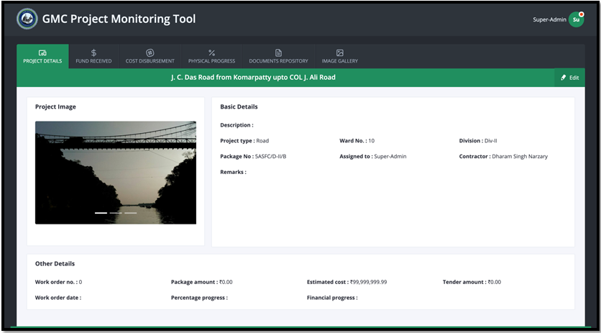



PROJECT DETAILS VIEW
If we open a project by clicking in the dashboard, then it will show all the details of the project.
In the tab bar, there are many other tabs for other details of the project.

Slide 11
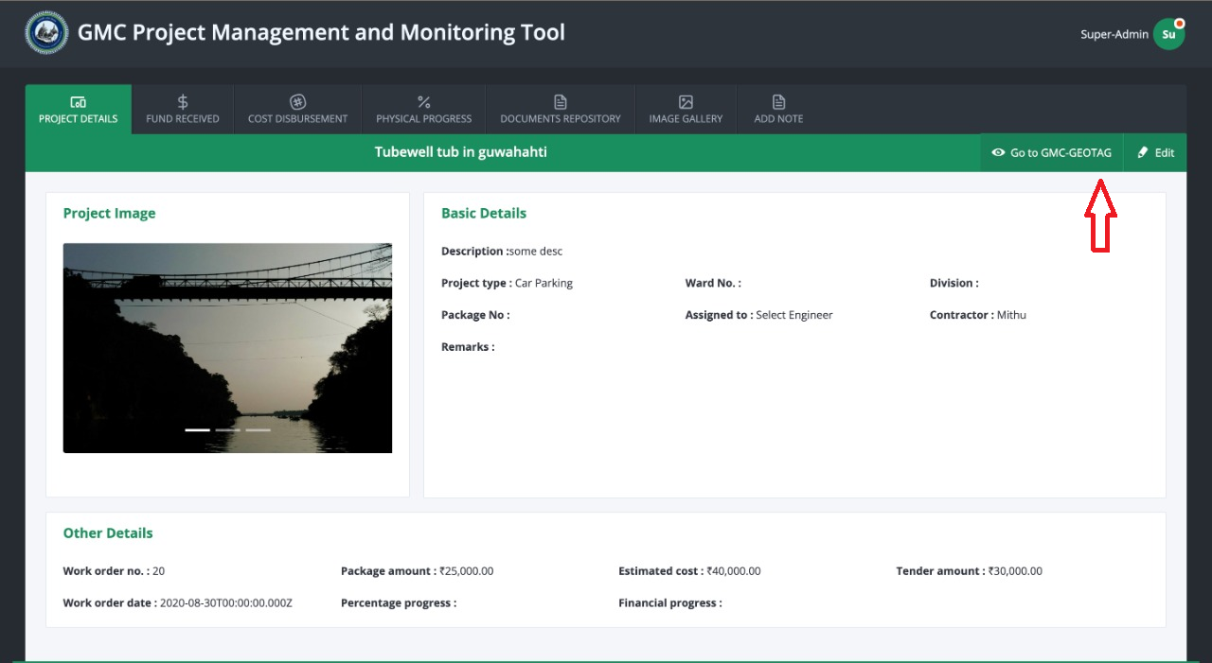
Geotag integration
Tight integration between GMC systems:
PMS to Geotag and vice-versa.
Can get geotag project directly

Slide 12
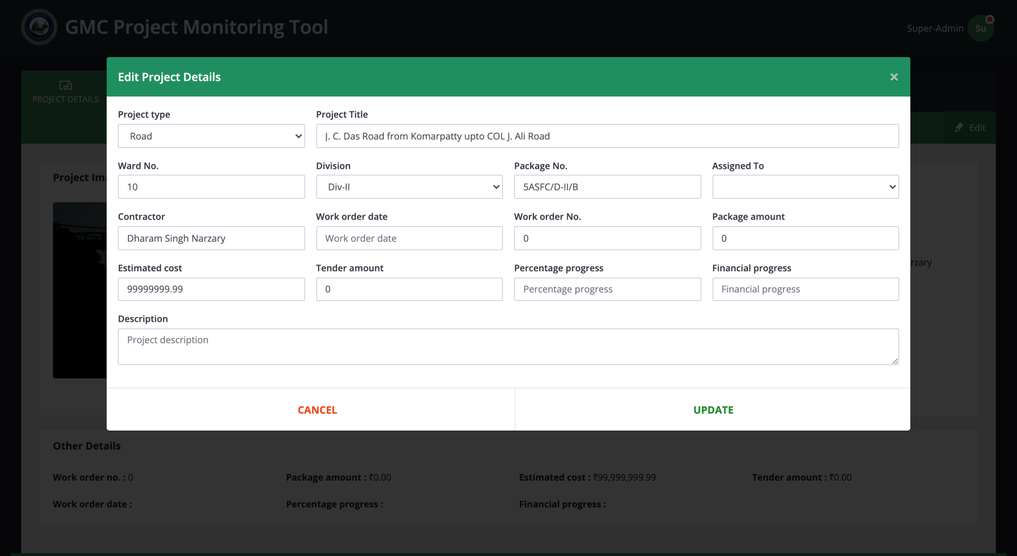
EDIT DETAILS
Clicking on the “Edit” button will lead to this page.

Slide 13
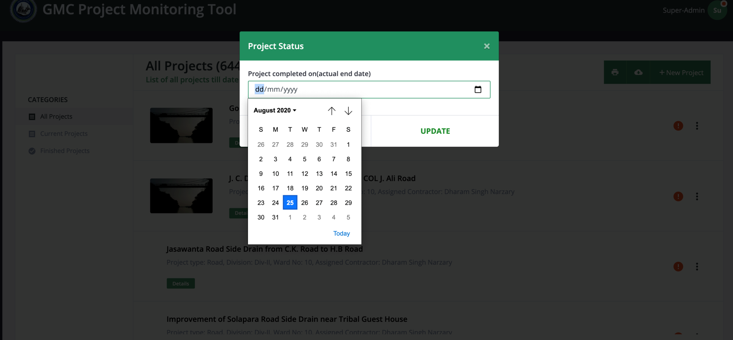
STATUS OF THE PROJECT
This tab records the Actual status of the project.
If the status is Completed, the actual End Date is to be provided by the engineer.
Once the project is set to be complete, no one except the admin can do any edit.

Slide 14
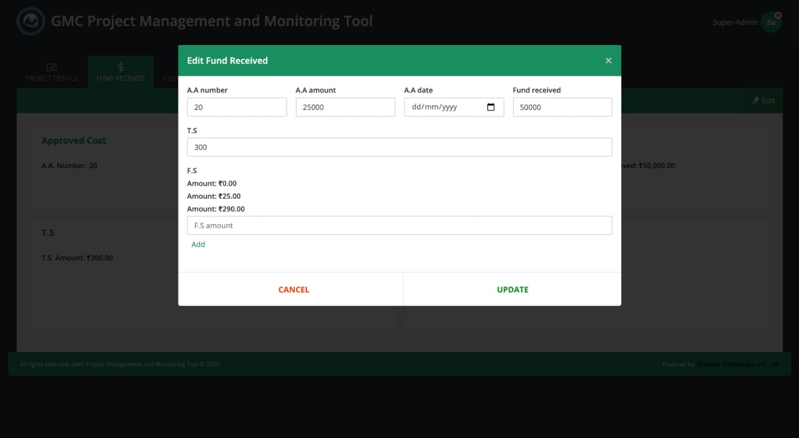
Project details and financials editable by authorized users

Slide 15
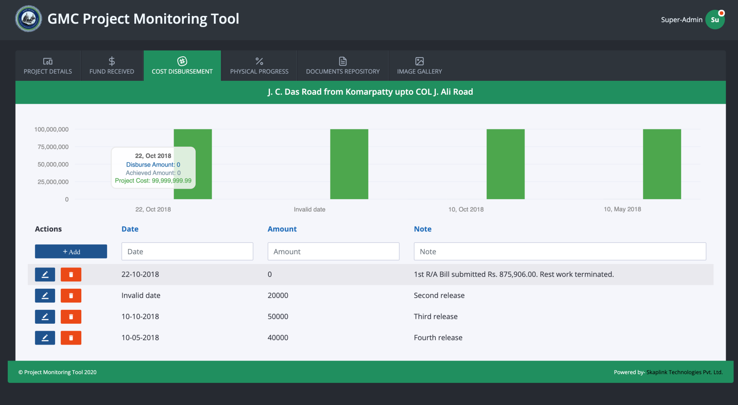
COST DISBURSEMENT
Project disbursements are captured and presented.
Disbursement information are presented as:
Visual Graph.
Percentage Bar.
Below the page there is a place where, the engineer can update new disbursement with the date, or delete any old disbursements.

Slide 16
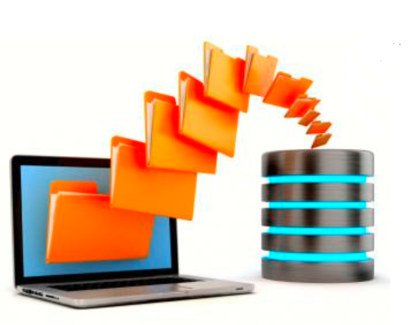
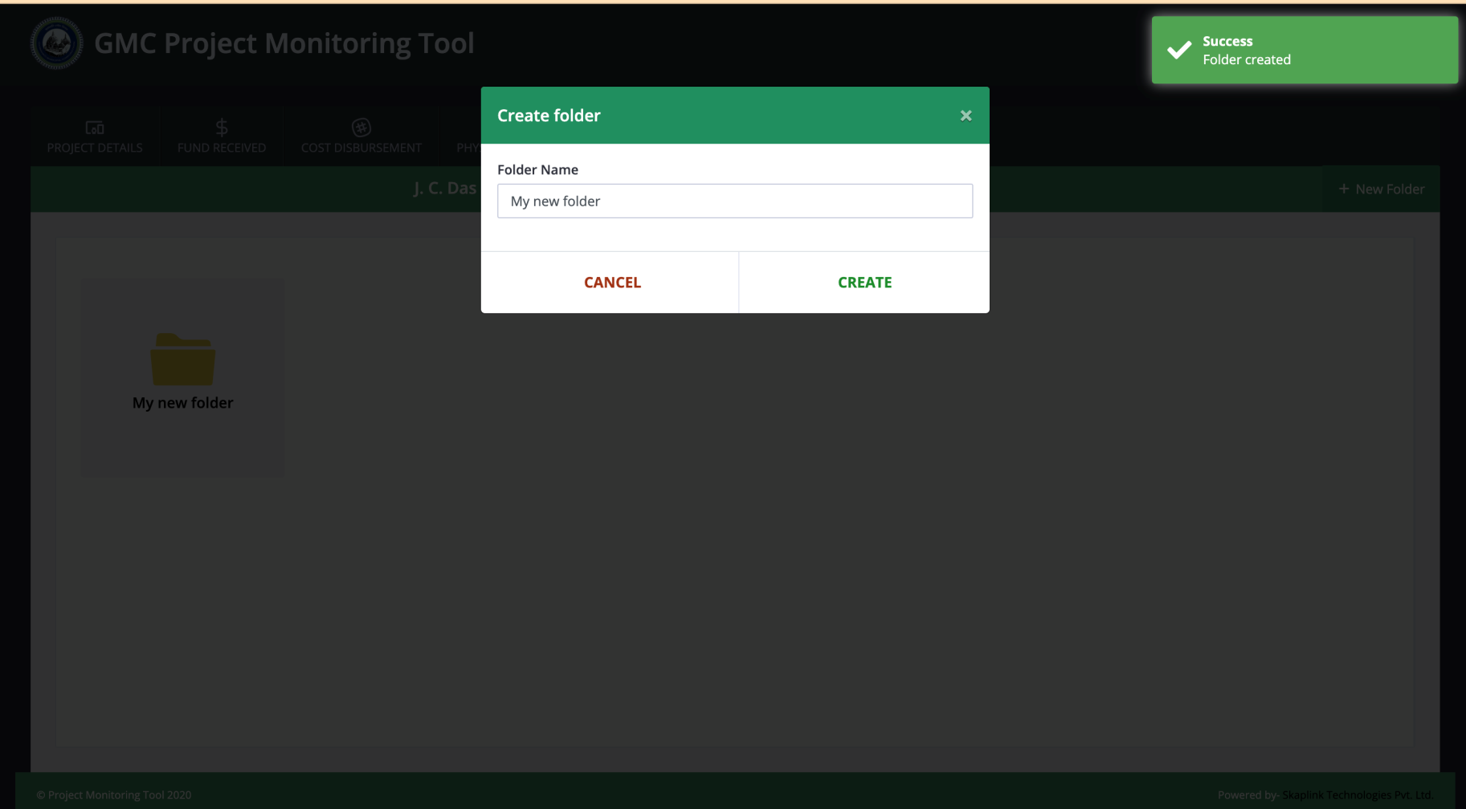
Project document repository
Project Document Management System (DMS)
Receive, track, manage
Store documents and reduce paper –
Go green!
Self service by Engineers

Slide 17
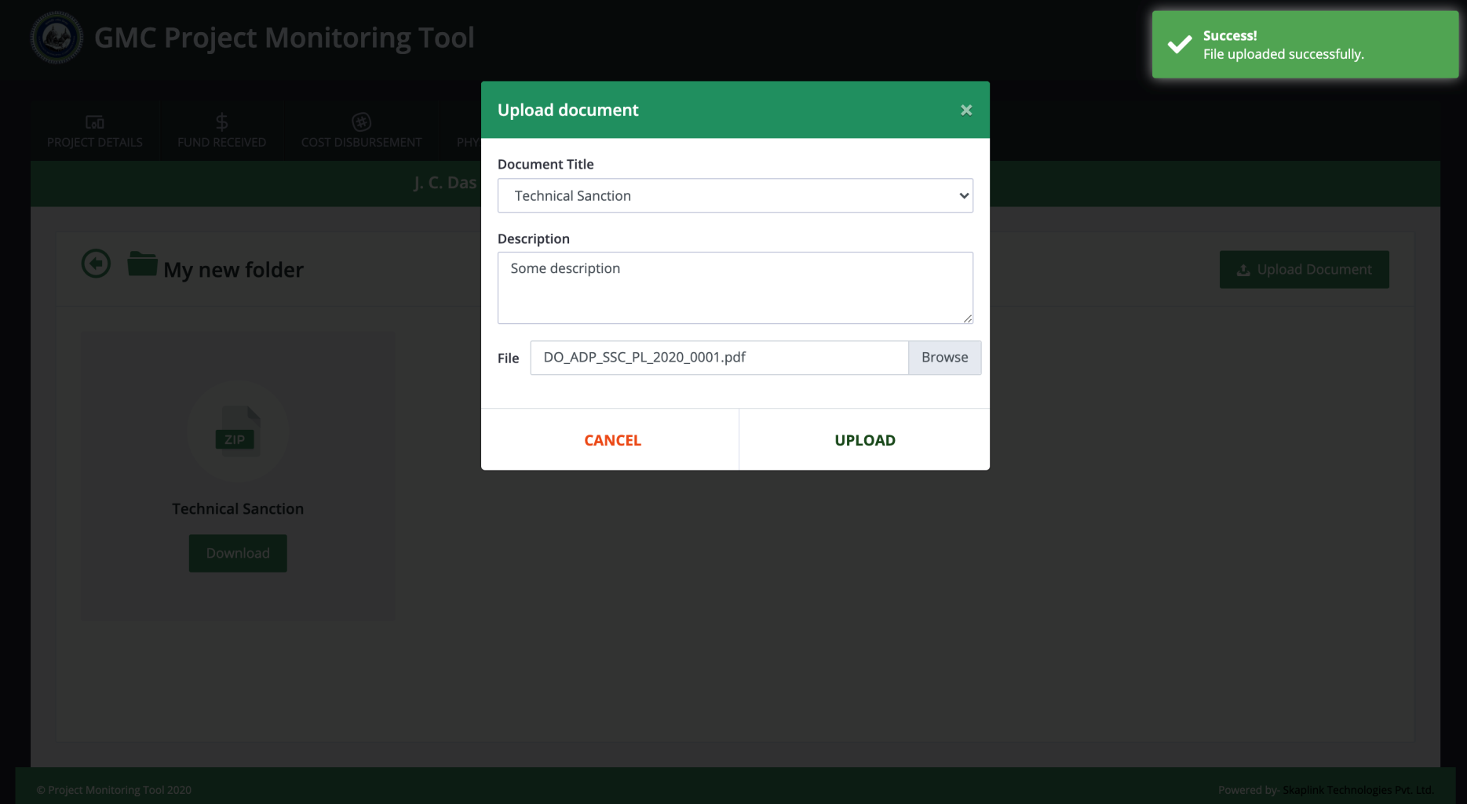
Project document repository – contd..
Documents Unloadable from device.

Slide 18
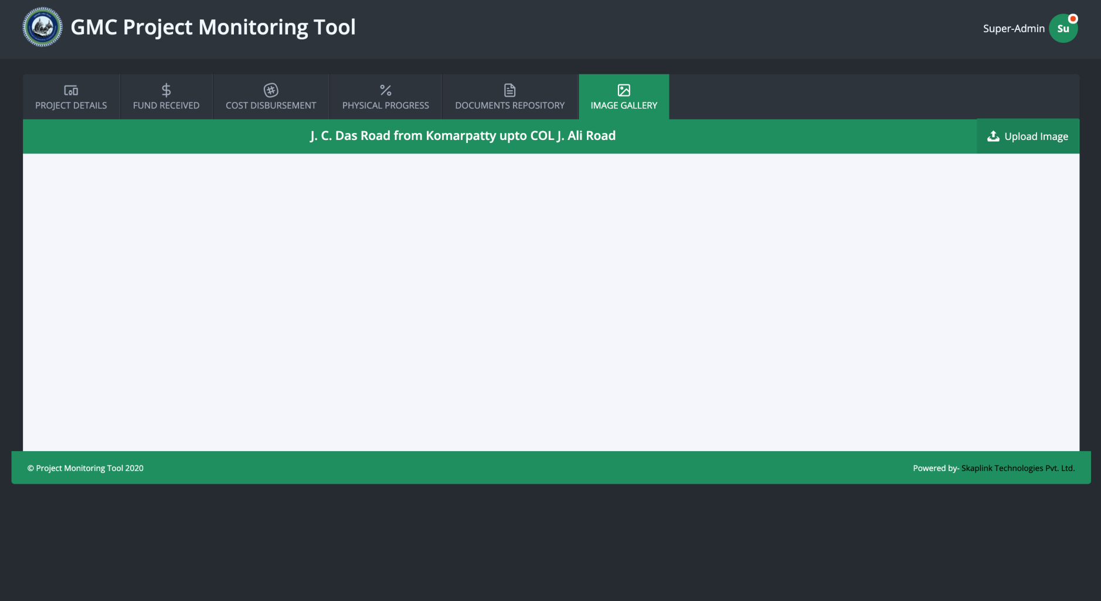
Image upload
Digital Images of a project are stored by uploading their scanned images.

Slide 19
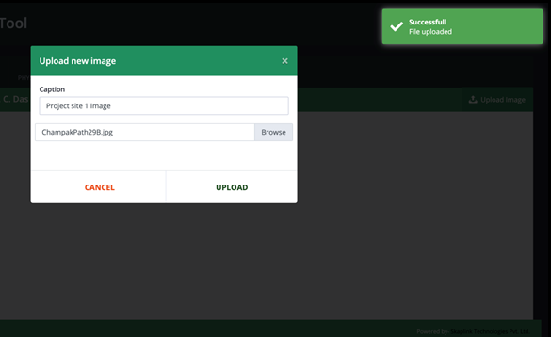
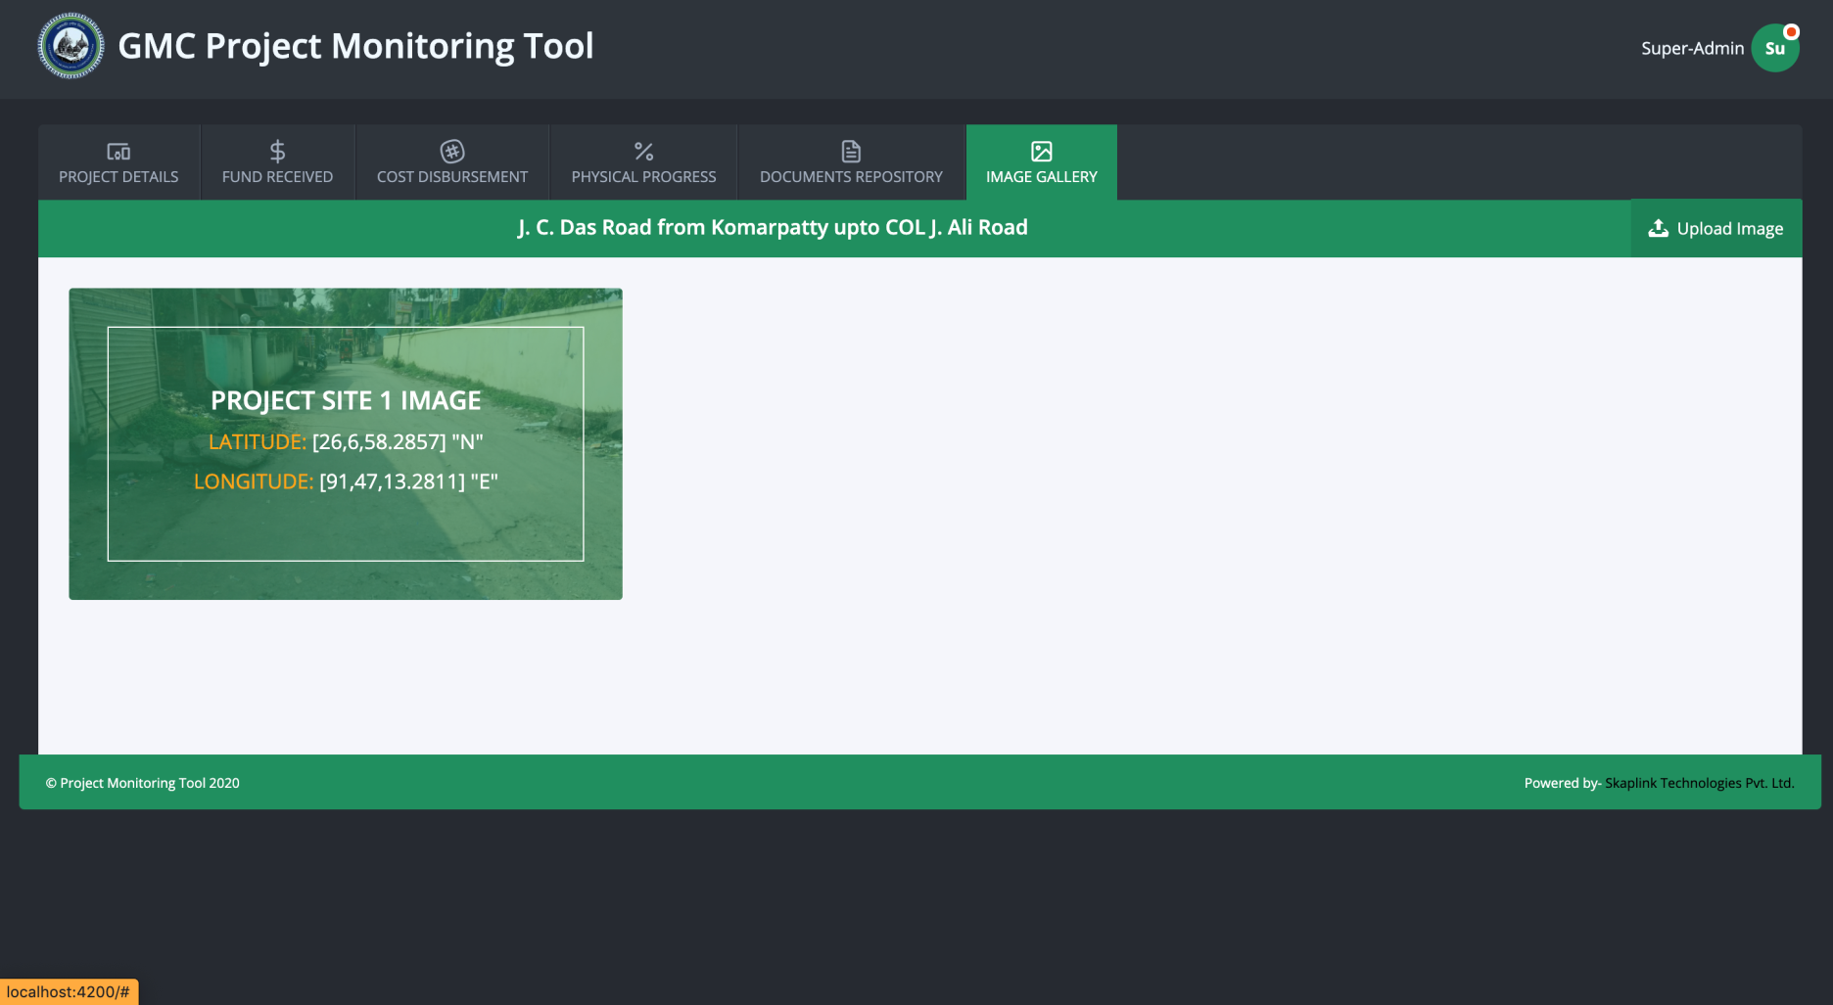
Image upload screen
Images can be uploaded from any device.
Image captions can be given.
The later image shows how it looks.

Slide 20
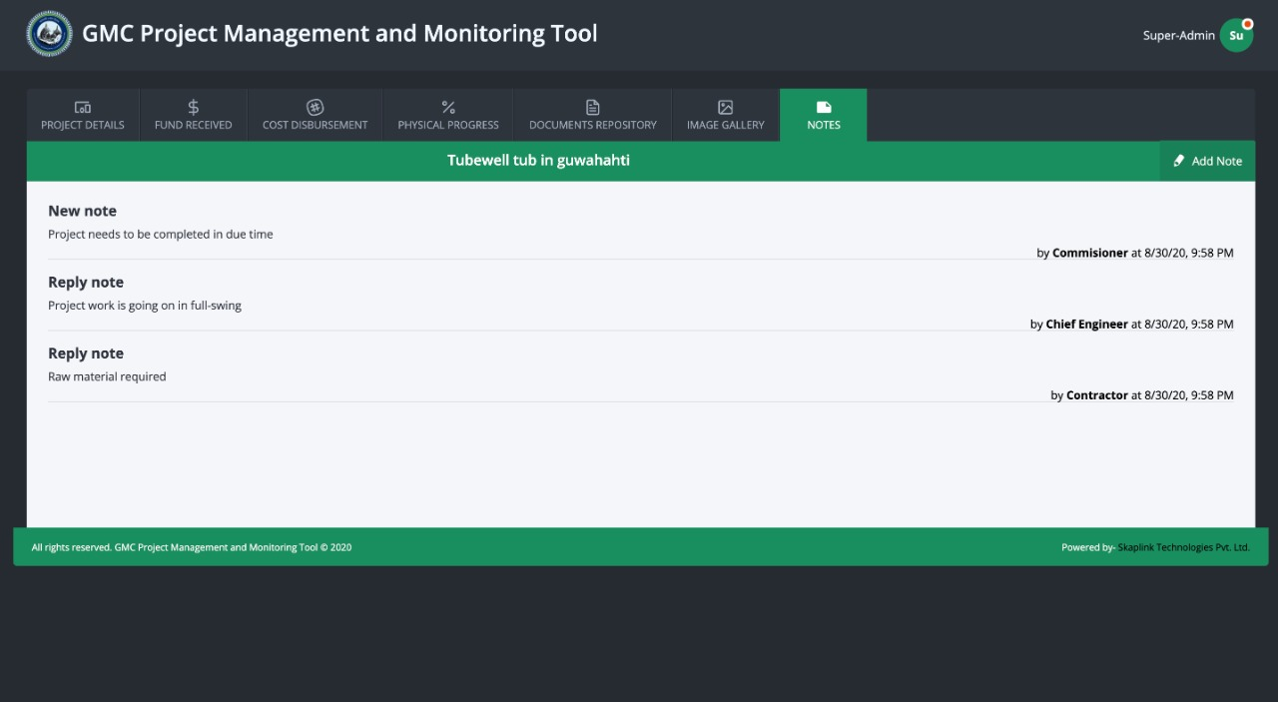
Notes on project files
Notes between officials can be maintained in the tool.
Notes provider and timeline captured.
History of notes at finger tips.

Slide 21
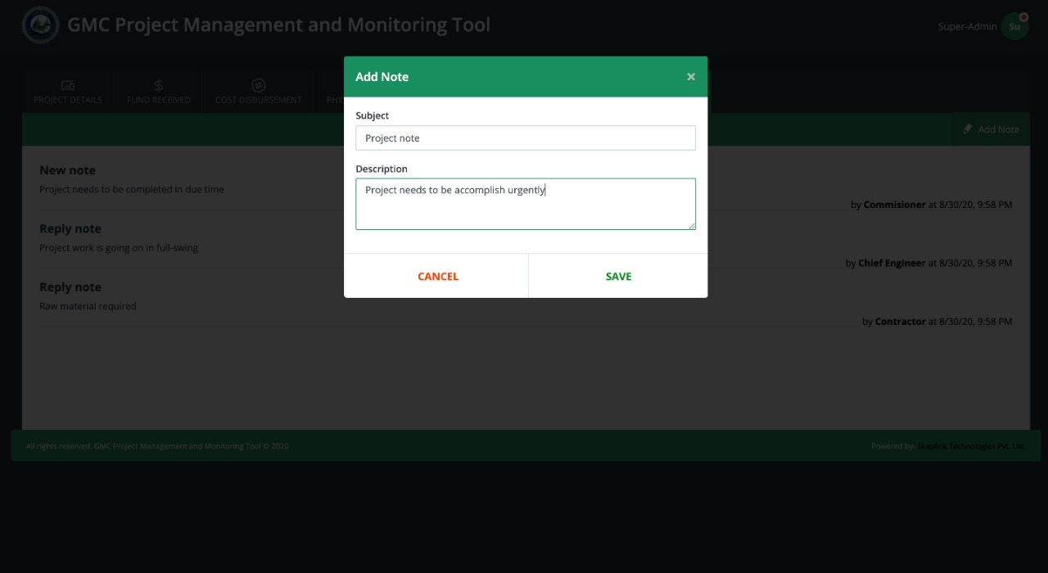
Notes contd…
Notes on file can be added by authorized users.

Slide 22
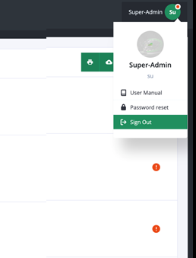
USER MANUAL / RESET PASSWORD/ SIGN OUT
In the top-right corner, clicking on the user’s photo three options appear.
They are: User Manual, Reset Password option, and Sign Out option.

Slide 23

Questions?

Slide 24
THANK YOU!

